Slide 1

PROG6212 POE
PART 3
Presentation by:
Leon muyambo

Slide 2


Intro to the key aspects of Contract Monthly Claim System
o1.
Feedback from lecturer for part 2
o2.
Key features of CMCS
o3.
Value of CMCS

Slide 3

Feedback from part 2
What I need to improve:
Error Handling & Display
Claim Status Tracking
Coordinators' View Design
Document Upload Feature

Slide 4
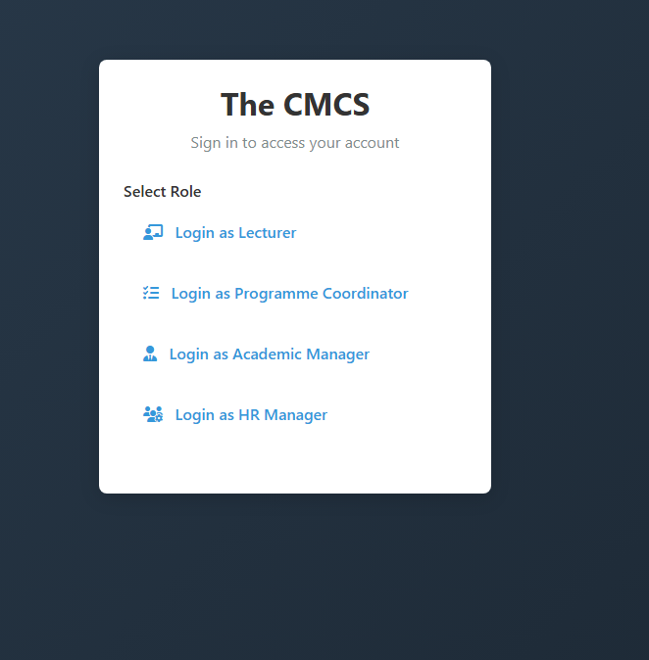
Key Feature 1:Multi-Role Access Control
The CMCS
Sign in to access your account
Four distinct user roles: Lecturer, Programme Coordinator, Academic Manager, HR Manager
Role-based dashboards: with customized functionality
Secure authentication: with session management
Overview of memory systems. RAM, ROM, and cache: Dive into the different types of computer memory systems, including random access memory (RAM), read-only memory (ROM), and cache. Explain how each type of memory functions, their purpose in data storage, and their impact on computer performance.

Slide 5

Key Feature 2: Automated Claims Workflow
Two-stage approval process: Coordinator → Manager
Automated validation against business rules
Real-time status tracking for all claims
Bulk approval capabilities for efficient processing

Slide 6



Key Feature 3: Smart Automation & Validation
Auto-calculation
Policy
Auto-verification
Auto-calculation of claim amounts (Hours × Rate)
Policy compliance checking (max hours, rate validation)
Auto-verification for coordinators and managers

Slide 7



Key Feature 4: Comprehensive Document Management
Secure file upload
Multiple format
Document download
Secure file upload for supporting documents
Multiple format support (PDF, DOCX, XLSX, images)
Document download with access control

Slide 8

Key Feature5: Advanced Reporting & Analytics
The CMCS gives HR powerful tools to understand create users and manage all teaching claims. They can create monthly reports to see the big picture of all payments and compare departments. They can also o deep dives into specific departments to check their spending and workload. The system also lets them download many invoices at once for easy record-keeping and payment processing. These tools help HR control costs, be transparent, and make smarter decisions for the university.

Slide 9
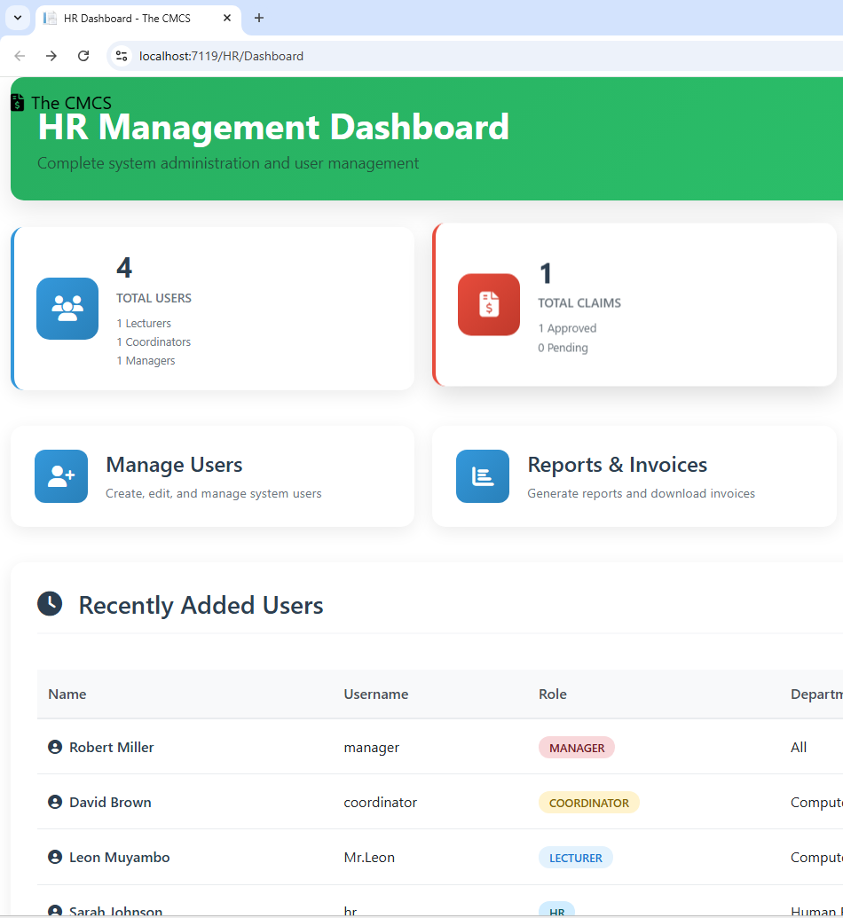
Key Feature5: HR Management System
Complete user lifecycle management
Department management
Role assignment and access control
System-wide oversight and monitoring

Slide 10

CMCS Core Values
o1.
Efficiency
o2.
Transparency
o3.
Accuracy
o4.
Security
o5.
User Experience
_{o.6}​
System Impact

Slide 11
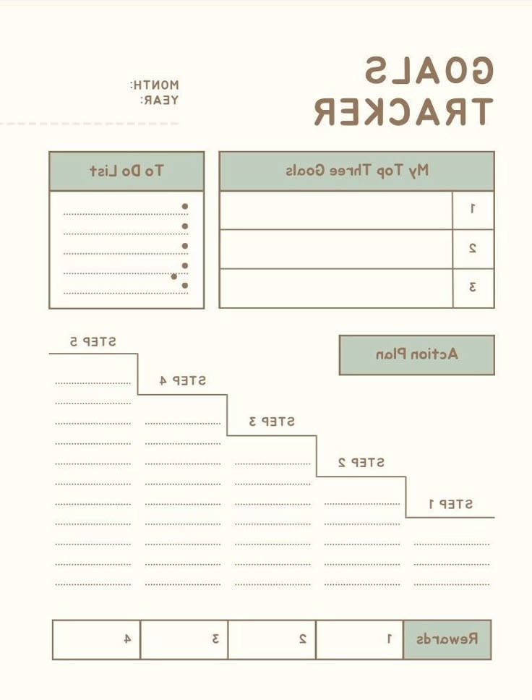
Value 1: Transparency
Real-time tracking of claim status
Clear audit trails for all actions
Complete visibility into approval workflows

Slide 12
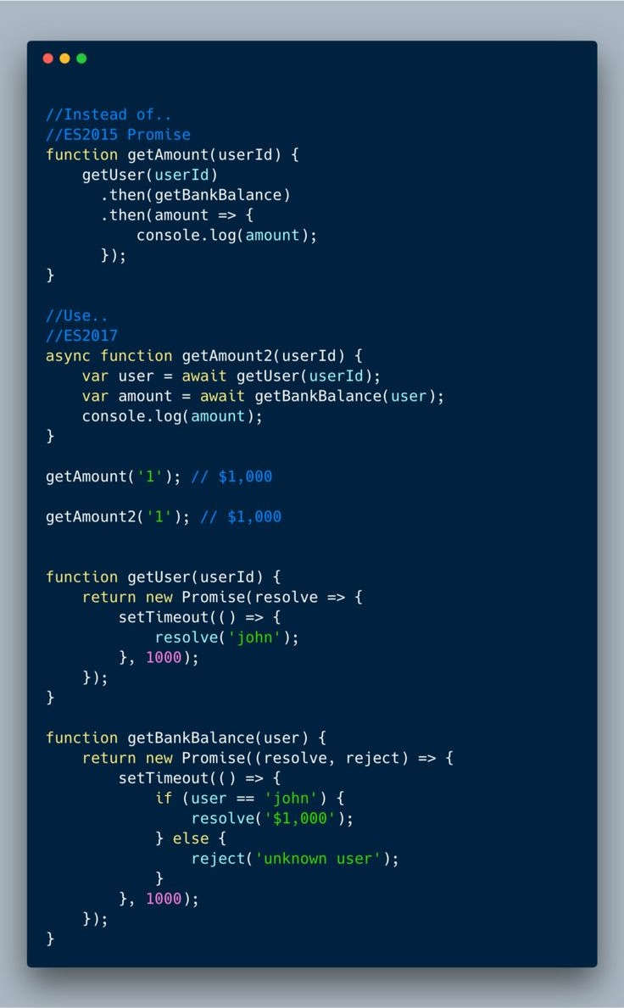
Value 2: Efficiency
Reduces paperwork by 90% through digital processing
Accelerates approval cycles from weeks to days
Automates repetitive tasks like calculations and validations

Slide 13

Value 3: Accuracy
Automated calculations eliminate human error
Policy enforcement ensures compliance
Validation rules maintain data integrity

Slide 14

Value 4: Security
Role-based access control protects sensitive data
Secure authentication prevents unauthorized access
Document protection with proper access controls

Slide 15
Value 5: User Experience
Intuitive interfaces for each user role
Responsive design works on all devices
Guided workflows reduce training needs

Slide 16
Value 5: System Impact
Streamlines the entire academic claims process
Provides insights through comprehensive analytics
Ensures compliance with institutional policies
Saves time for all stakeholders (lecturers, coordinators, managers, HR)
Reduces administrative overhead and processing costs

Slide 17
Conclusion
The Academic Claims Management System (CMCS) is a comprehensive digital platform that automates and streamlines the entire process of submitting, reviewing, approving, and managing academic teaching claims. It replaces manual paperwork with an efficient digital workflow, providing transparency, accuracy, and significant time savings for lecturers, coordinators, academic managers, and HR departments while ensuring policy compliance and financial control.
The system serves as a centralized hub for all claims-related activities, transforming what was traditionally a slow, paper-intensive process into a streamlined, automated, and transparent digital experience.

Slide 18

Thank you

